Slide 1
MongoDB Introduction

Slide 2
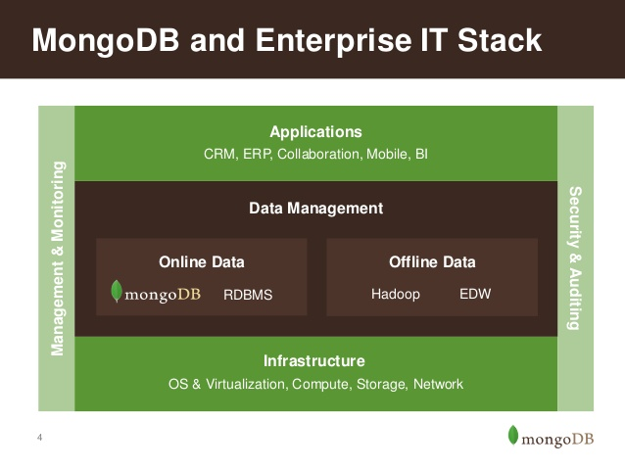
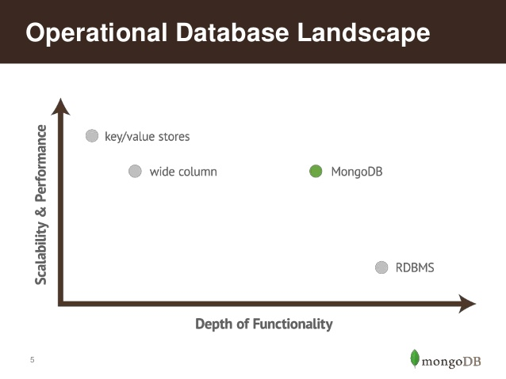
Why MongoDB
MongoDB Philosophy

Slide 3
What is MongoDB
MongoDB (from humongous) is a cross-platform document oriented database
Schema-free document database
NoSQL database
Written in C++
Open-source project that mainly driven by 10gen Inc.
10gen Inc. also offers professional services around MongoDB
Has driver to all most every popular language programming
Notes:
MongoDB (from humongous) is a cross-platform document oriented database . Classified as a NoSQL database, MongoDB eschews the traditional table-based relational database structure in favor of JSON -like documents with dynamic schemas (MongoDB calls the format BSON), making the integration of data in certain types of applications easier and faster. Released under a combination of the GNU Affero General Public License and the Apache License, MongoDB is free and open-source software
MongoDB stores data in the form of documents, which are JSON-like field and value pairs.
Documents are analogous to structures in programming languages that associate keys with values (e.g. dictionaries, hashes,
maps, and associative arrays).
Formally, MongoDB documents are BSON documents. BSON is a binary representation of JSON with additional type information. In the documents, the value of a field can be any of the BSON data types, including other documents, arrays, and arrays of documents

Slide 4
Why MongoDB-MongoDB is:
General Purpose
Rich data model
Full featured indexes
Sophisticated query language
Easy to Use
Easy mapping to object oriented code
Native language drivers in all popular languages
Simple to setup and manage
Fast & Scalable
Operates at in-memory speed wherever possible
Auto-shading built in
Dynamically add / remove capacity with no downtime

Slide 5
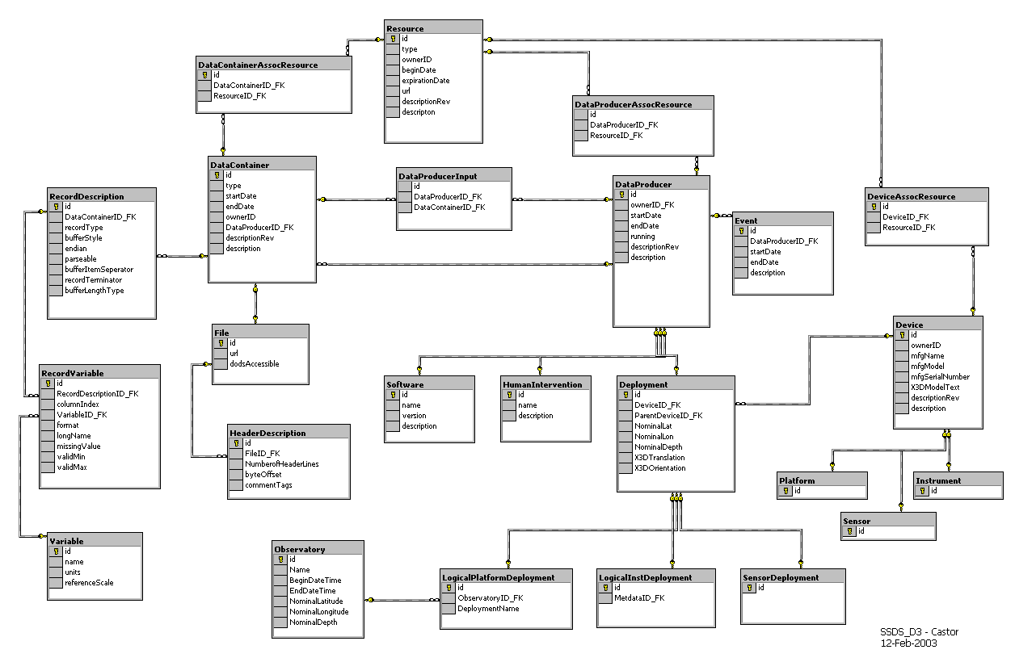
Why MongoDB-MongoDB is Easy to Use
{
title: ‘MongoDB’,
contributors: [
{ name: ‘Eliot Horowitz’,
email: ‘eliot@10gen.com’ },
{ name: ‘Dwight Merriman’,
email: ‘dwight@10gen.com’ }
],
model: {
relational: false,
awesome: true
}
}

Slide 6

Why MongoDB- Schema Free
MongoDB does not need any pre-defined data schema.
Every document could have different data!
{name: “will”,
eyes: “blue”,
birthplace: “NY”,
aliases: [“bill”, “la ciacco”],
loc: [32.7, 63.4],
boss: ”ben”}
{name: “jeff”,
eyes: “blue”,
loc: [40.7, 73.4],
boss: “ben”}
{name: “brendan”,
aliases: [“el diablo”]}
{name: “matt”,
pizza: “DiGiorno”,
height: 72,
loc: [44.6, 71.3]}
{name: “ben”,
hat: ”yes”}
Notes:
Applications enforce the data “schema” and integrity, much like MUMPS does in VistA

Slide 7


Why MongoDB-MongoDB is Fast and Scalable
Better data locality
In-Memory
Caching
Distributed Architecture
Replication /HA
Relational
MongoDB
Horizontal Scaling

Slide 8
Why MongoDB-History
Jan 2015
2.6.7
3.0
2009
C++
10gen
HUMONGOUS
2007

Slide 9
Why MongoDB-Features of MongoDB
Document Oriented Database
Adhoc queries
Indexing
High Performance
High Availability
Sharding
Easy Scalability
File Storage
Rich Query Language
Load Balancing
Replication
Notes:
Document-oriented
Documents (objects) map nicely to programming language data types
Embedded documents and arrays reduce need for joins
Dynamically-typed (schemaless) for easy schema evolution
No joins and no multi-document transactions for high performance and easy scalability
High performance
No joins and embedding makes reads and writes fast
Indexes including indexing of keys from embedded documents and arrays
Optional streaming writes (no acknowledgements)
High availability
Replicated servers with automatic master failover
Easy scalability
Automatic sharding (auto-partitioning of data across servers)
Reads and writes are distributed over shards
No joins or multi-document transactions make distributed queries easy and fast
Eventually-consistent reads can be distributed over replicated servers
Rich query language

Slide 10
Why MongoDB-Where should you use MongoDB
Big Data
Content Management and Delivery
Mobile and Social Infrastructure
User Data Management
Data Hub
Notes:
Document-oriented
Documents (objects) map nicely to programming language data types
Embedded documents and arrays reduce need for joins
Dynamically-typed (schema less) for easy schema evolution
No joins and no multi-document transactions for high performance and easy scalability
High performance
No joins and embedding makes reads and writes fast
Indexes including indexing of keys from embedded documents and arrays
Optional streaming writes (no acknowledgements)
High availability
Replicated servers with automatic master failover
Easy scalability
Automatic Sharding (auto-partitioning of data across servers)
Reads and writes are distributed over shards
No joins or multi-document transactions make distributed queries easy and fast
Eventually-consistent reads can be distributed over replicated servers
Rich query language

Slide 11
Why MongoDB-MongoDB to SQL Terminology
MongoDB | SQL
database | database
collection | table
document | record (row)
field | column
linking/embedded documents | join
primary key (_id field) | primary key (user designated)
index | index

Slide 12
Why MongoDB-Important Terminology
Database
Database is a physical container for collections. Each database gets its own set of files on the file system. A single MongoDB server typically has multiple databases.
Collection
Collection is a group of MongoDB documents. It is the equivalent of an RDBMS table. A collection exists within a single database. Collections do not enforce a schema. Documents within a collection can have different fields. Typically, all documents in a collection are of similar or related purpose.
Document
A document is a set of key-value pairs. Documents have dynamic schema. Dynamic schema means that documents in the same collection do not need to have the same set of fields or structure, and common fields in a collection's documents may hold different types of data.

Slide 13
Why MongoDB-Data Model
Document based (max 16 MB).
Documents are in BSON formats consisting of field / value pairs.
Each document stored in a collection.
Schema less.

Slide 14
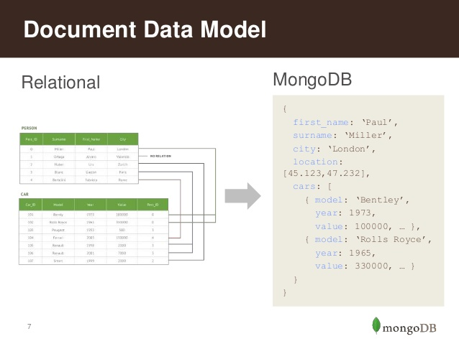
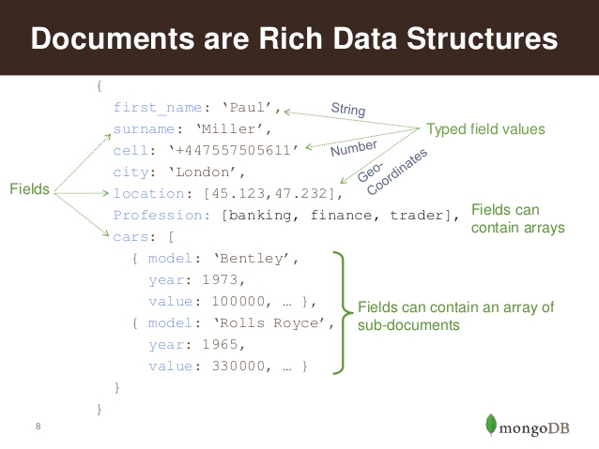
Why MongoDB-Data Model

Slide 15
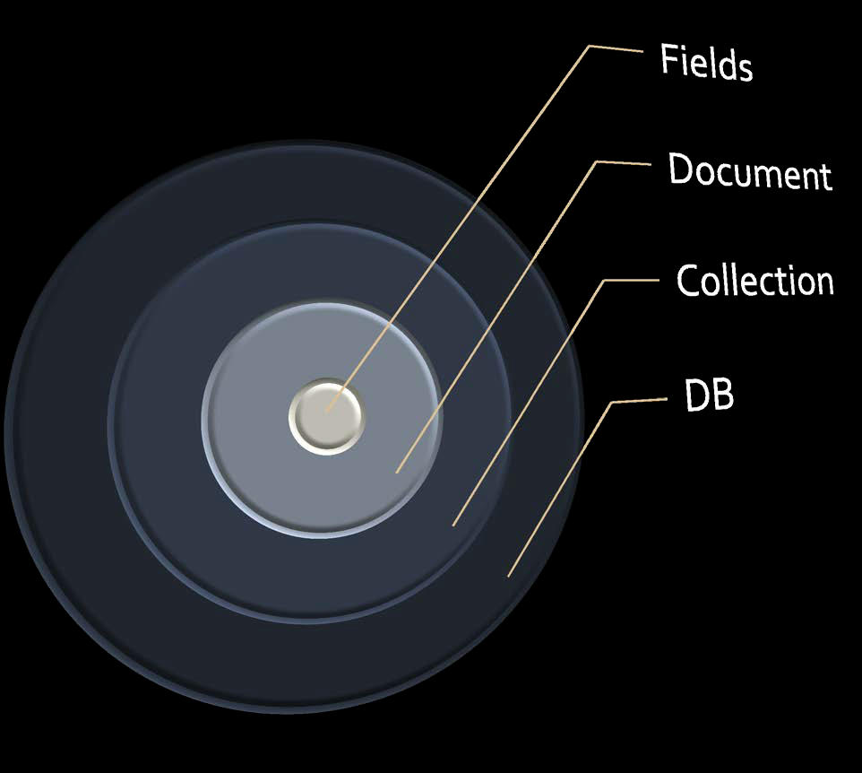
Why MongoDB-MongoDB Data Model

Slide 16
Why MongoDB-The Basics of MongoDB
A MongoDB instance may have one or more Databases.
A database may have one or more Collections.
A collection may have zero or more Documents.
A document may have one or more Fields.
MongoDB indexes function much like their RDBMS counterparts.

Slide 17
Why MongoDB-Database Server and Client
mongod
server
mongo
client

Slide 18
When not to use
Not suitable for Highly transactional systems .
Not suitable for where the data model is designed up front.
Not suitable for Tightly coupled systems

Slide 19
Documents, Collections and Databases-
MongoDB ‘s Data Model
A Database has “Collections”
Collections have “Documents”
Documents have “Fields”
Fields are key = value pairs

Slide 20
Setting up MongoDB-Getting Started
Install mongodb on windows from the link given below:
http://www.mongodb.org/downloads
Make sure you get correct version of MongoDB depending upon your windows version.
MongoDB for Windows 64-bit: This build type of MongoDB runs on any 64-bit version of Windows latest than Windows XP, involve Windows Server 2008 R2 and Windows 7 64-bit.

Slide 21
Setting up MongoDB-
What MongoDB does, How it works
MongoDB is a server process that runs on Windows/Linux , Os X.
It can be run both as a 32 or 64-bit application. We recommend running in 64-bit mode, since Mongo is limited to a total data size of about 2GB for all databases in 32-bit mode.
Clients connect to the MongoDB process, optionally authenticate themselves if security is turned on, and perform a sequence of actions, such as inserts, queries and updates.

Slide 22
Starting the MongoDB Server
Create a directory where MongoDB stores all its data.
The MongoDB default data directory path is \data\db.
Create the data folder in D:\
Set the Path.
Run mongod.exe
To start MongoDB server, we need to run mongod.exe

Slide 23
Starting the MongoDB Server (contd.)
D:\set up\mongodb>mongod.exe --dbpath "d:\set up\mongodb\data"
This will show waiting for connections message on the console output indicates that the mongod.exe process is running successfully.
Now to run the mongodb you need to open another command prompt and issue the following command.

Slide 24
Using MongoDB Shell
D:\set up\mongodb\bin>mongo.exe
MongoDB shell version: 2.2.0
connecting to: test
Welcome to the MongoDB shell

Slide 25
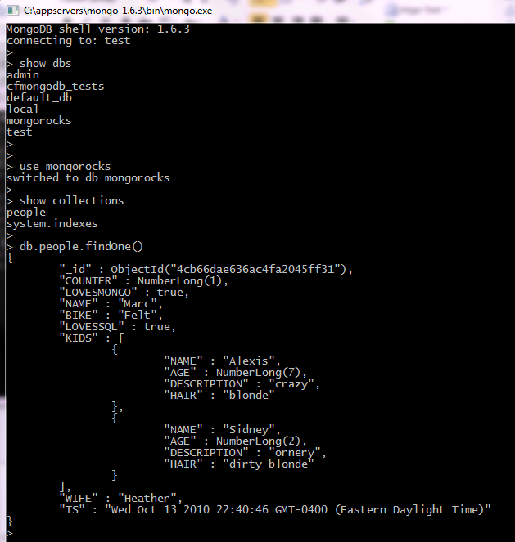
Creating and dropping database-
D>mongo
>help()
>show dbs
>use <dbname>
>show collections
>db.collectionName.findOne()
>db.collectionName.find()
>db.help()
>db.collectionName.help()
Notes:
>switched to db cgdb >db.dropDatabase()
>{ "dropped" : “cgdb", "ok" : 1 }

Slide 26
Creating and dropping collections
This command insert employees collection in database
> db.createCollection("employees")

Slide 27
DataTypes
Integer − This type is used to store a numerical value. Integer can be 32 bit or 64 bit depending upon your server.
Boolean − This type is used to store a boolean (true/ false) value.
Double − This type is used to store floating point values.
Min/ Max keys − This type is used to compare a value against the lowest and highest BSON elements.
Arrays − This type is used to store arrays or list or multiple values into one key.
Timestamp − ctimestamp. This can be handy for recording when a document has been modified or added.
Object − This datatype is used for embedded documents.
Null − This type is used to store a Null value.
Symbol − This datatype is used identically to a string; however, it's generally reserved for languages that use a specific symbol type.
Date − This datatype is used to store the current date or time in UNIX time format. You can specify your own date time by creating object of Date and passing day, month, year into it.
Object ID − This datatype is used to store the document’s ID.
Binary data − This datatype is used to store binary data.
Code − This datatype is used to store JavaScript code into the document.
Regular expression − This datatype is used to store regular expression.

Slide 28
Summary
What is NOSQL database
Advantages of NOSQL
Why MongoDB
MongoDB Document database
MongoDB data model
Mongo Shell
Establishing Connection
Understand about Collection
on, document and fields

